Slide 1
Advanced Artificial Intelligence
Week # 8
Dr. Qurat Ul Ain
Assistant Professor Dept. of AI & DS
FAST NUCES, Islamabad
Email: quratul.ain@isb.nu.edu.pk

Slide 2
K Nearest Neighbor
9
Introduction
Instance based Learning
KNN Algorithm
Distance Functions
Decision Boundaries
Effect of K
Selection of K
Pros and Cons

Slide 3
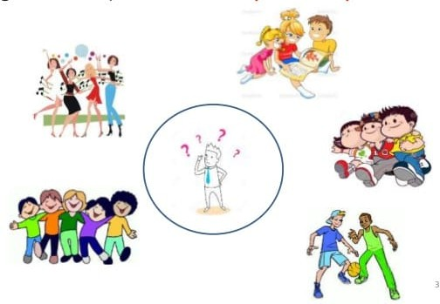
“Tell me who your neighbors are, and I’ll tell you who you are”

Slide 4
Introduction
Most of the machine learning algorithms are parametric.
What do we mean by parametric?
Let’s say if we are trying to model a linear regression model with one dependent variable and one independent variable. The best fit we are looking is the line equations with optimized parameters.
The parameters could be the intercept and coefficient. For any classification algorithm, we will try to get a boundary which successfully separates different target classes.
KNN is a non-parametric algorithm that uses the neighbor points information to predict the target class.
Fix & Hodges proposed K-nearest neighbor classifier algorithm in the year of 1951 for performing pattern classification task.

Slide 5
Different Learning Methods
Eager Learning
When it receives dataset, it starts classifying
Does not wait for test data to learn
So takes more time learning and less time classifying data
Instance-based Learning
Learning=storing all training instances (store data without learning)
Classification=start classifying data when it receive test data
So takes less time learning and more time classifying data
Referred to as “Lazy” learning
Notes:
Key Difference:
Eager Learning: Prepares a global model upfront, optimizing for faster predictions.
Instance-based Learning: Stores data and performs computations when predictions are needed, optimizing for flexibility.

Slide 6
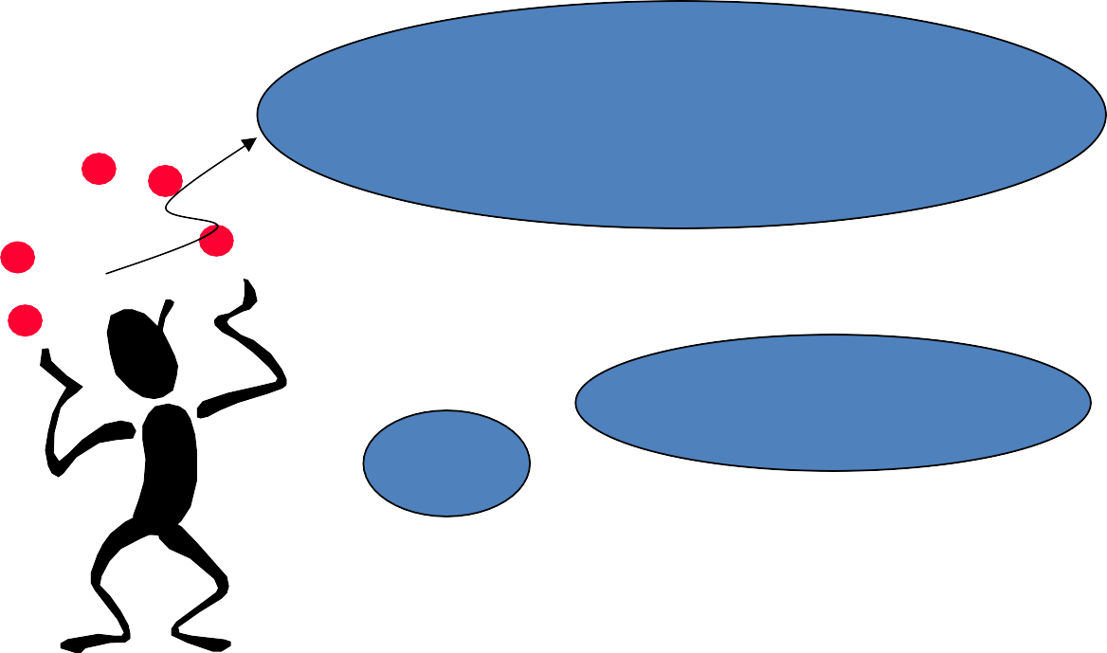

Different Learning Methods
Eager Learning
Any random movement
=>It’s a mouse
I saw a mouse!

Slide 7
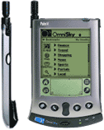




Instance-based Learning
Its very similar to a Desktop!!

Slide 8
K-Nearest Neighbor
Simple, but a very powerful classification algorithm
Classifies based on a similarity measure
Most basic instance-based method
Supervised learning
Non-parametric
Lazy learning
Does not “learn” until the test example is given
Whenever we have a new data to classify, neighbors from the training data | we | find its K-nearest 10

Slide 9
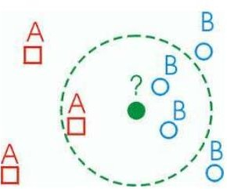
KNN Classification Approach
K nearest neighbors is a simple algorithm that stores all available cases and classifies new cases based on a similarity measure (e.g., distance functions).
The KNN algorithm assumes that similar things exist in close proximity. In other words, similar things are near to each other.
A case is classified by a majority vote of its neighbors, with the case being assigned to the class most common amongst its K nearest neighbors measured by a distance function.
If K = 1, then the case is simply assigned to the class of its nearest neighbor.

Slide 10
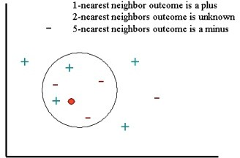
Guess
Learning is just storing the representations of the training examples in D.
Testing instance x:
Compute similarity between x and all examples in D.
Assign x the category of the most similar example in D.

Slide 11
KNN- Different names
K-Nearest Neighbors
Memory-Based Reasoning
Example-Based Reasoning
Instance-Based Learning
Case-Based Reasoning
Lazy Learning

Slide 12
KNN Algorithm
Determine parameter k= number of nearest neighbors.
Calculate the distance between the query instance and all the training samples.
An arbitrary instance is represented by (a₁(x), a₂(x), a₃(x),.., a_{n}(x))
a_{i}(x) denotes features
Sort the distance and determine the nearest neighbors.
Gather the category Y of the nearest neighbors.
Use simple majority of the category of nearest prediction value of the query instance.
neighbors as the
14

Slide 13
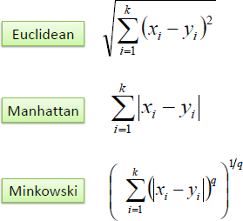
Distance Functions

Slide 14
Distance Functions
It should also be noted that all three distance measures are only valid for continuous variables.
In the instance of categorical variables, the Hamming distance must be used.
It also brings up the issue of standardization of the numerical variables between 0 and 1 when there is a mixture of numerical and categorical variables in the dataset.

Slide 15
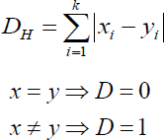
Hamming Distance

Slide 16
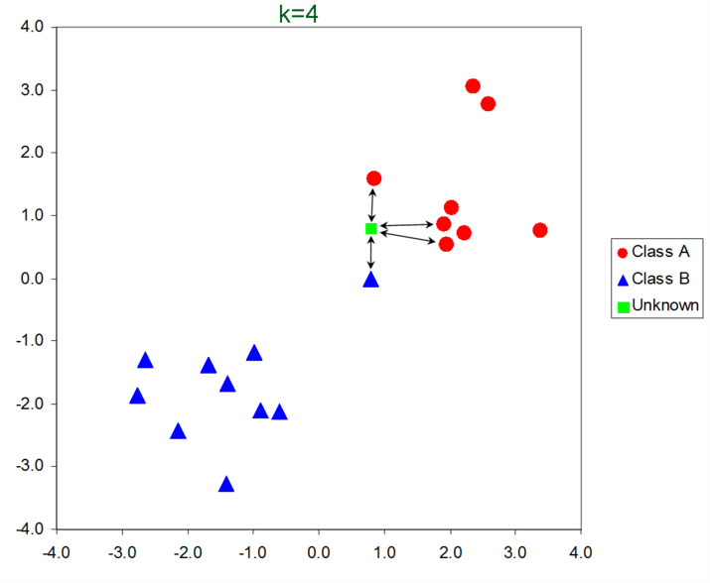
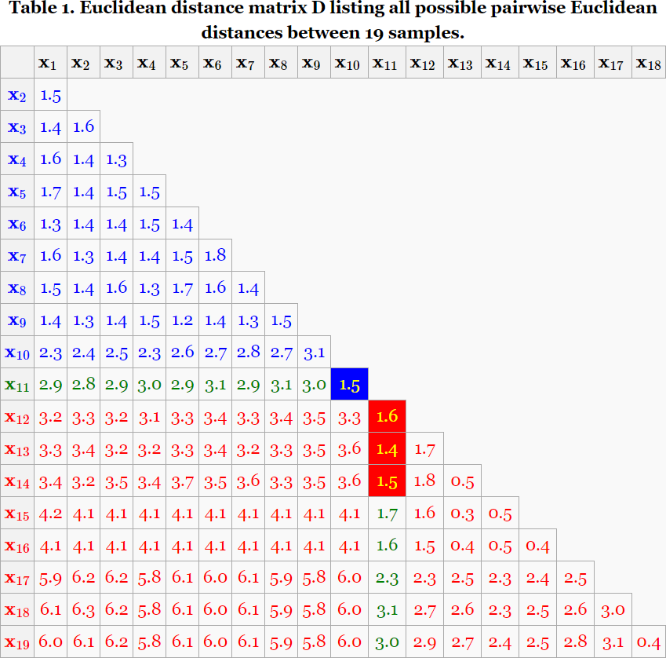
KNN Example
18

Slide 17
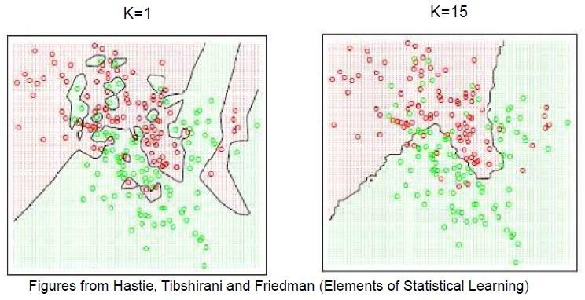
Effect of K
Larger k produces smoother boundary effect
When K==N, always predict the majority class
Which model is better between K=1 and K=15?

Slide 18
Selection of K
Choosing the optimal value for K is best done by first inspecting the data.
In general, a large K value is more precise as it reduces the overall noise but there is no guarantee.
Cross-validation is another way to retrospectively determine a good K value by using an independent dataset to validate the K value.
To select the K that’s right for your data, we run the KNN algorithm several times with different values of K and choose the K that reduces the number of errors we encounter while maintaining the algorithm’s ability to accurately make predictions when it’s given data it hasn’t seen before.
Historically, the optimal K for most datasets has been between 3-10. That produces much better results than 1NN.

Slide 19
Selection of K
Here are some things to keep in mind:
As we decrease the value of K to 1, our predictions become less stable. Just think for a minute, imagine K=1 and we have a query point surrounded by several reds and one green (which can be noisy label), but the green is the single nearest neighbor. Reasonably, we would think the query point is most likely red, but because K=1, KNN incorrectly predicts that the query point is green.
Inversely, as we increase the value of K, our predictions become more stable due to majority voting, and thus, more likely to make more accurate predictions (up to a certain point). Eventually, we begin to witness an increasing number of errors. It is at this point we know we have pushed the value of K too far.
In cases where we are taking a majority vote among labels, we usually make K an odd number to have a tiebreaker.

Slide 20
KNN – Number of Neighbors
If K=1, select the nearest neighbour
If K>1
For classification select the most frequent neighbour.
For regression calculate the average of K neighbours.
Rule of thumb is k < sqrt(n), n is number of examples

Slide 21
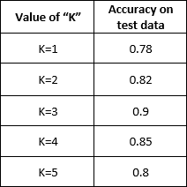
Cross Validation
In order to better understand the need for cross-validation, let me first recap on how to determine the right value of “K”?
Suppose, we are given a dataset and we split it into training data and test data in the ratio 70:30. Meaning, I keep 70% of my total data to train my model and rest 30% to test it.
Next, I train my model with different values of “K” and capture its accuracy on my test data. Assume we get a table like below:

Slide 22
Cross Validation
Now, if you observe then at K=3, I get the highest accuracy of 90% and after that, we see a decreasing trend in the accuracy. So, basis that we come to the conclusion that my appropriate value for K=3.
This all sounds good but there is a small problem with it.
The whole objective of machine learning is generalizing.
If you think about KNN, we used the test data to basically determine the right value of K and the train data to find the nearest neighbors. We got the accuracy of 90% on the test data which we also used to determine the right value of “K”.
Can I say that since I achieved an accuracy of 90% on my test data, I will be able to retain this approximate level of accuracy on my future unseen data?
The answer is NO

Slide 23
Cross Validation
In order to confidently say that we can achieve an accuracy of approximately 90% on future unseen data, I need to first test this model on unseen data.
But how do we do that? we had the data set splitted into 70:30 ratio of training and test data. We have no more data available with me.
In order to solve this problem, we can use cross-validation.
In cross-validation, instead of splitting the data into two parts, we split it into 3. Training data, cross-validation data, and test data. Here, we use training data for finding nearest neighbors, we use cross-validation data to find the best value of “K” and finally we test our model on totally unseen test data. This test data is equivalent to the future unseen data points.

Slide 24
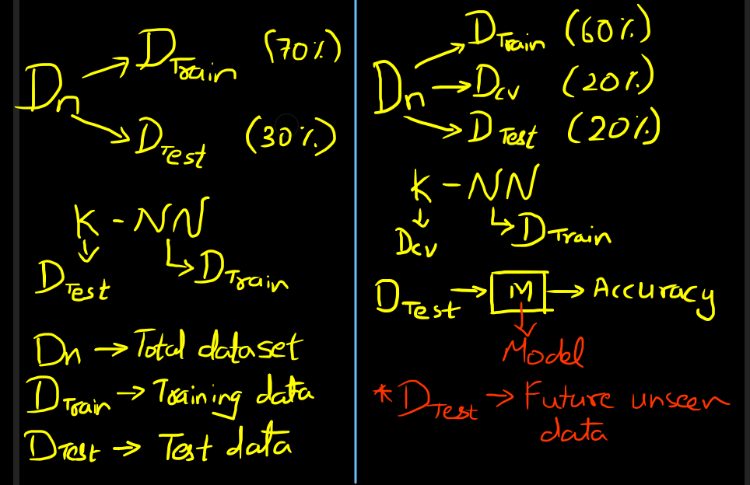
Cross Validation-Holdout vs k-fold
If you refer to the above image, we have split the data in the ratio of 60:20:20, where we use 60% of the data to train our model, 20% for cross-validation, and rest 20% for testing.
In this process of cross-validation, we are losing almost 20% of the data, which we would have otherwise used for training and it’s a known fact that more the training data, better is the algorithm.
So, is there a way to somehow use that 20% of the cross-validation data under training data?
And the answer to the question is k-fold cross-validation

Slide 25
k-fold Cross Validation
After splitting the total data set (D_{n}) into training (D_{Train}) and test (D_{Test}) data set, in the ratio of 80:20, we further randomly split the training data into 4 equal parts.
^{D}Train
D_{n} | DTrain
 | DTest
D₁ | D₂ | D₃ | D₄
D₁, D₂, D₃, and D₄ are the four randomly split equal parts of D_{Train}. Once done with the splitting, we proceed as follows:
Step-1: For K=1, we pick D1, D2, and D3 as our training data set and set D4 as our cross- validation data and find the nearest neighbors and calculate its accuracy.
Step-2: Again, for K=1, we pick D1, D2, and D4 as our training data set and set D3 as our
cross-validation data, we find the nearest neighbors and calculate its accuracy.
Repeat the above steps with D2 and D1 as cross-validation data set and calculate the corresponding accuracy. Once done with it, we get 4 accuracies for the same value of K=1. So we consider the mean of these accuracies and assign it as the final value when my K=1.
27

Slide 26
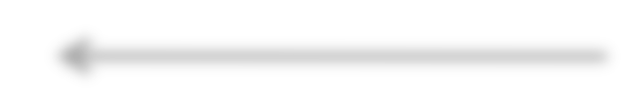



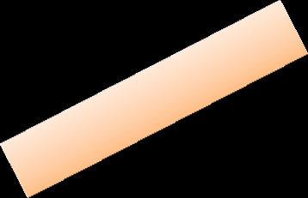

KNN Classification – Distance
Age Loan Default Distance
25 $40,000 N 102000
35 $60,000 N 82000
45 $80,000 N 62000
20 $20,000 N 122000
35 $120,000 N 22000
52 $18,000 N 124000
23 $95,000 Y 47000
40 $62,000 Y 80000
60 $100,000 Y 42000
48 $220,000 Y 78000
33 $150,000 Y 8000
48 $142,000 ?
D = (x − x )² + ( y − y )²
1 2 1 2
Euclidean Distance

Slide 27
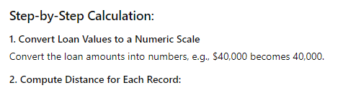
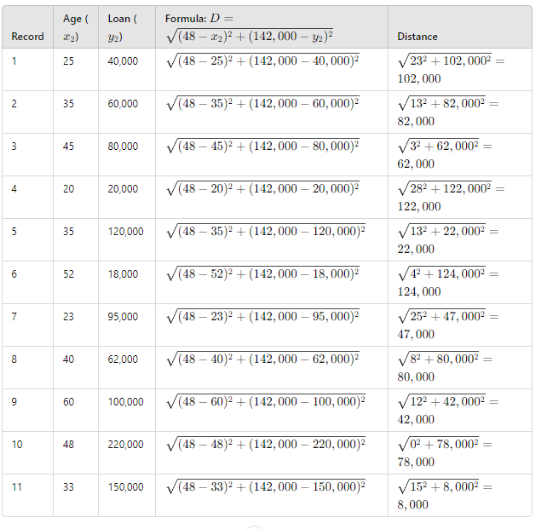
KNN Classification – Distance

Slide 28
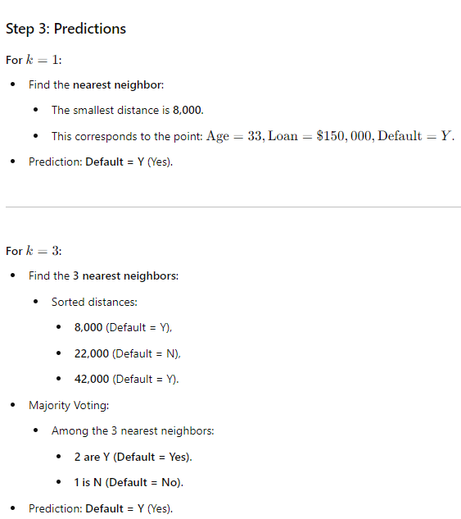
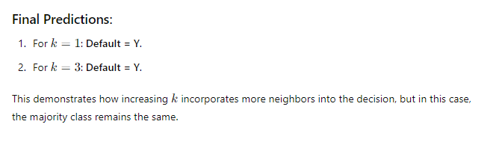
KNN Classification – Distance

Slide 29
Example
Question: k=3
Name | Age | Gender | Sports
Ahmed | 32 | M | Football
Amir | 40 | M | Neither
Ayesha | 16 | F | Cricket
Sana | 34 | F | Cricket
Usman | 55 | M | Neither
Umer | 40 | M | Cricket
Mark | 20 | M | Neither
Angelina | 15 | F | Cricket
Smith | 55 | M | Football
Laura | 15 | F | Football
Kristine | 5 | F | ?

Slide 30
Example
Since both features are of different categories (numerical and categorical, therefore first we will transform in one category so we will change the gender to numerical form for example select 0 for male and 1 for female
Name | Age | Gender | Sports
Ahmed | 32 | 0 | Football
Amir | 40 | 0 | Neither
Ayesha | 16 | 1 | Cricket
Sana | 34 | 1 | Cricket
Usman | 55 | 0 | Neither
Umer | 40 | 0 | Cricket
Mark | 20 | 0 | Neither
Angelina | 15 | 1 | Cricket
Smith | 55 | 0 | Football
Laura | 15 | 1 | Football
Kristine | 5 | 0 | ?
38

Slide 31
Example
Now apply Euclidean distance to compute the distance of Kristine against each instance in our dataset.
Name | Age | Gender | Distance | Sports
Ahmed | 32 | 0 | 27.02 | Football
Amir | 40 | 0 | 35.01 | Neither
Ayesha | 16 | 1 | 11 | Cricket
Sana | 34 | 1 | 9 | Cricket
Usman | 55 | 0 | 50.01 | Neither
Umer | 40 | 0 | 35.01 | Cricket
Mark | 20 | 0 | 15 | Neither
Angelina | 15 | 1 | 10 | Cricket
Smith | 55 | 0 | 50 | Football
Laura | 15 | 1 | 10.05 | Football
Kristine | 5 | 0 |  | ?

Slide 32
Example
Now select the three closest instances (as k=3) from Kristine based on this distance computed.
Name | Age | Gender | Distance | Sports
Ahmed | 32 | 0 | 27.02 | Football
Amir | 40 | 0 | 35.01 | Neither
Ayesha | 16 | 1 | 11 | Cricket
Sana | 34 | 1 | 9 | Cricket
Usman | 55 | 0 | 50.01 | Neither
Umer | 40 | 0 | 35.01 | Cricket
Mark | 20 | 0 | 15 | Neither
Angelina | 15 | 1 | 10 | Cricket
Smith | 55 | 0 | 50 | Football
Laura | 15 | 1 | 10.05 | Football
Kristine | 5 | 0 |  | ?

Slide 33
Example
Finally majority voting rule will be applied to decide the label of the test instance, which is cricket in this case.
Name | Age | Gender | Distance | Sports
Ahmed | 32 | 0 | 27.02 | Football
Amir | 40 | 0 | 35.01 | Neither
Ayesha | 16 | 1 | 11 | Cricket
Sana | 34 | 1 | 9 | Cricket
Usman | 55 | 0 | 50.01 | Neither
Umer | 40 | 0 | 35.01 | Cricket
Mark | 20 | 0 | 15 | Neither
Angelina | 15 | 1 | 10 | Cricket
Smith | 55 | 0 | 50 | Football
Laura | 15 | 1 | 10.05 | Football
Kristine | 5 | 0 |  | Cricket

Slide 34
Computational Complexity
Basic KNN algorithm stores all examples
Very expensive for a large number of samples
But we need a large number of samples for KNN to work well!

Slide 35

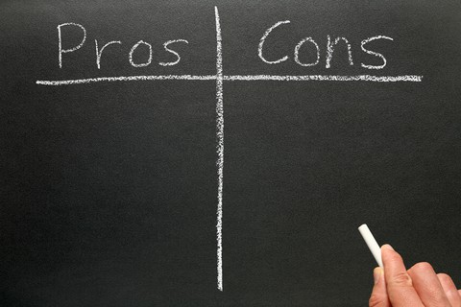
Pros and Cons of KNN
1.The algorithm is simple and easy to implement.
1. The algorithm gets significantly slower as the number of examples and/or predictors/independent variables increase.
2.There’s no need to build a model, tune several parameters, or make additional assumptions.
Expensive-To determine the nearest neighbour of a query point q, must compute the distance to all N training examples
Storage Requirements-Must store all training data.
High Dimensional Data- Required amount of
training data increases exponentially with dimension, so, computational cost also increases dramatically
3.The algorithm is versatile. It can be used for classification, regression, and searching.
The KNN algorithm is robust to noisy training data.
The NN algorithm learns very quickly.
56

Slide 36
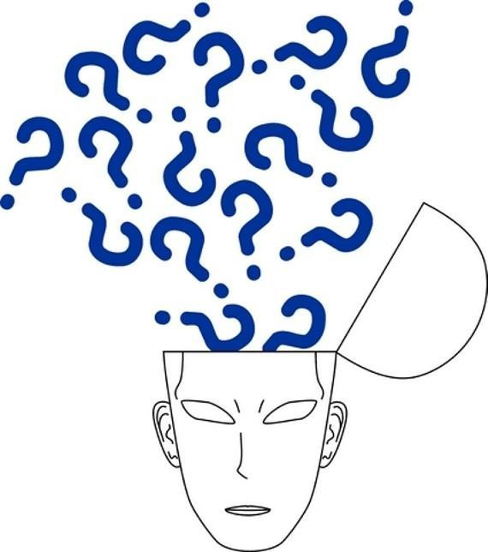
For any query Feel Free to ask
43

